Slide 1
Food Delivery Time Analysis
Data visualization & insights to optimize speed, satisfaction, and fleet performance

Slide 2
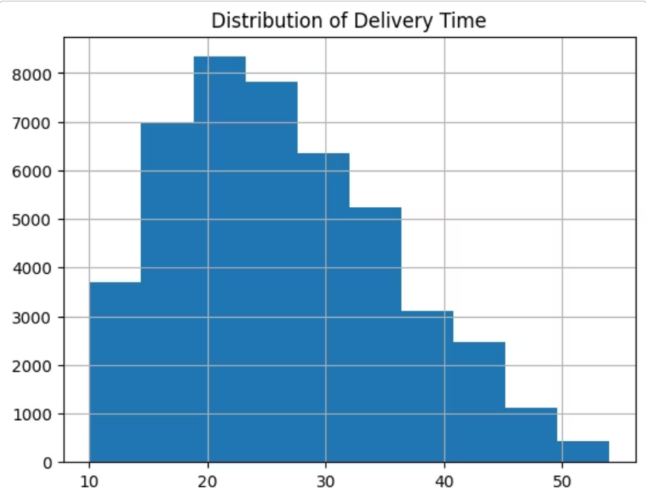
Delivery Time Distribution
What the spread tells us
Most deliveries cluster in a central time range
Long tail of outliers signals operational friction
Identify peak vs. off-peak delivery patterns

Slide 3
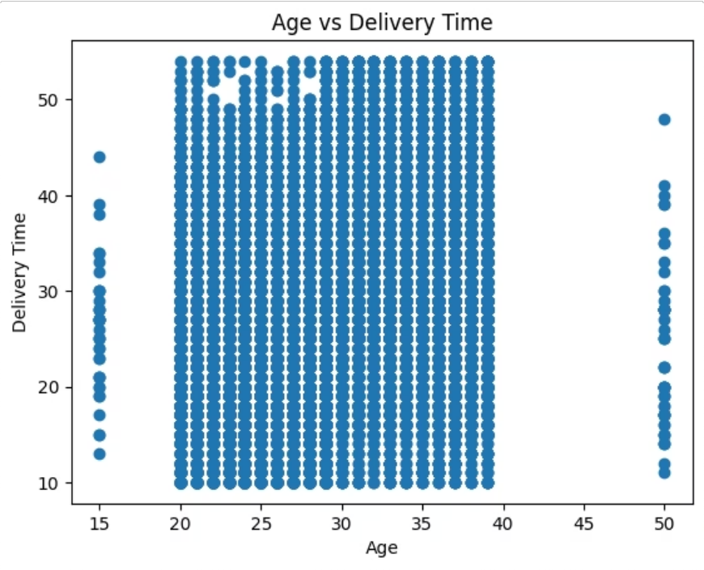
Age vs. Delivery Time
Customer segment insight
Delivery expectations may vary by age group — understanding these patterns helps tailor service levels and communication.
Look for age cohorts with consistently longer or shorter delivery windows.

Slide 4
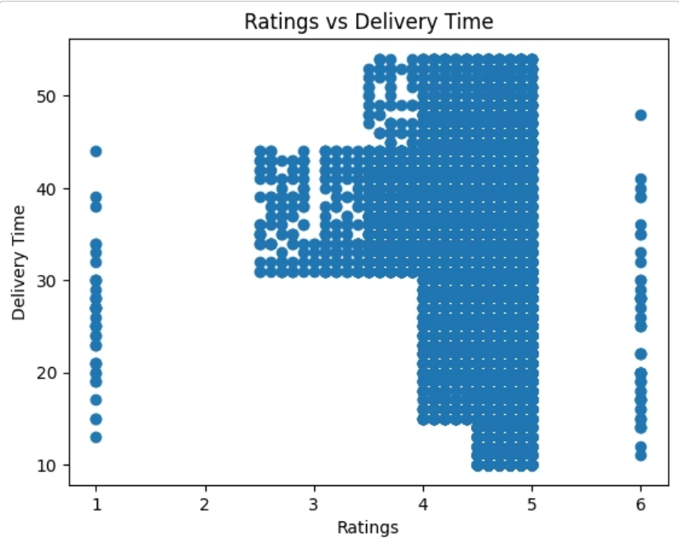
Ratings vs. Delivery Time
Speed and satisfaction are linked — faster deliveries tend to drive higher ratings, but consistency matters most.

Slide 5
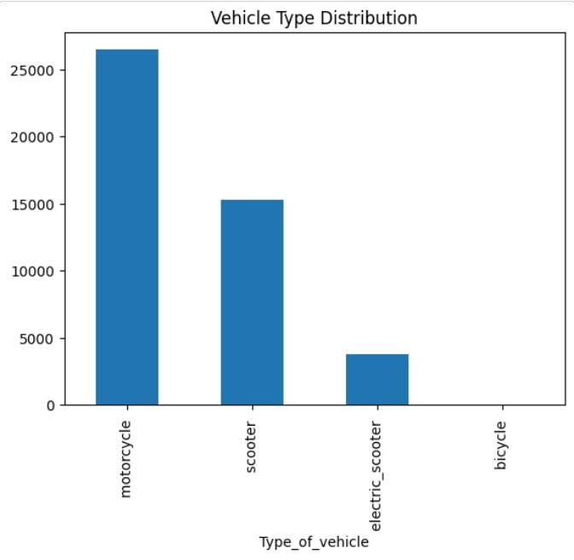
Vehicle Type Breakdown
Fleet composition
Each vehicle type serves different distance and density profiles. Understanding the mix helps optimize dispatch logic and zone coverage.
Cars
Longer routes, higher capacity
Motorcycles
Urban agility, faster last-mile
Bicycles
Dense zones, eco-friendly

Slide 6
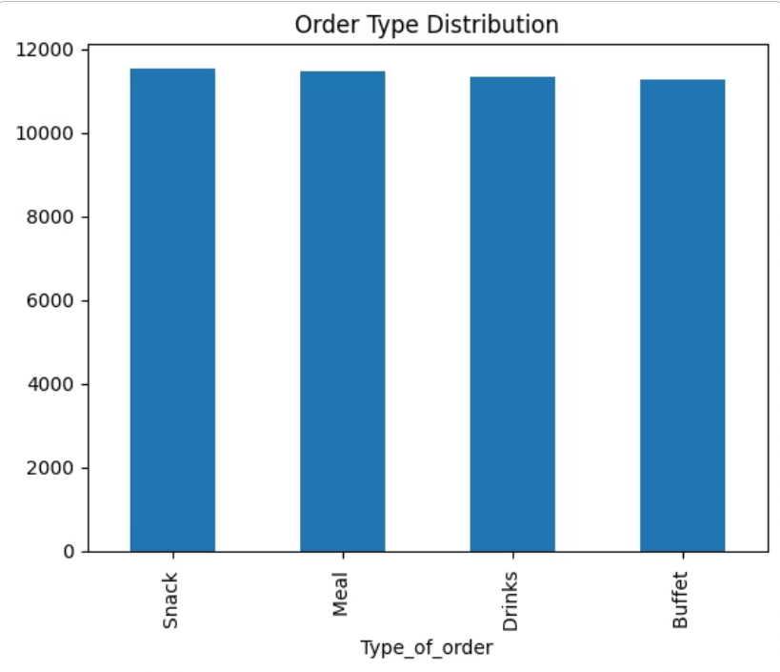
Order Type Analysis
Order complexity impact
Order type — single item, combo, or group — directly affects prep time and delivery routing. Segment performance by order type to isolate bottlenecks.

Slide 7
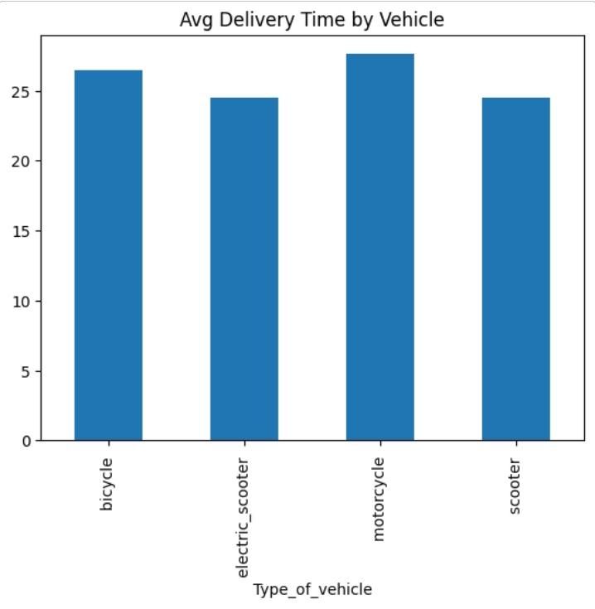
Average Delivery Time by Vehicle
Fleet performance benchmark
Compare average delivery times across vehicle types to identify which fleet segments underperform — and why.
Use this view to guide fleet allocation decisions by zone and time of day.

Slide 8
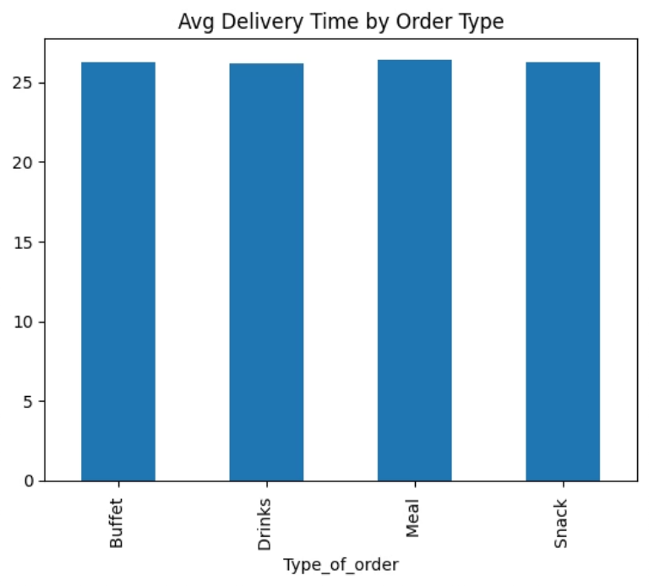
Average Delivery Time by Order Type
Where delays concentrate
Certain order types consistently take longer. Pinpointing these helps restaurants and dispatchers set accurate ETAs and manage customer expectations.

Slide 9
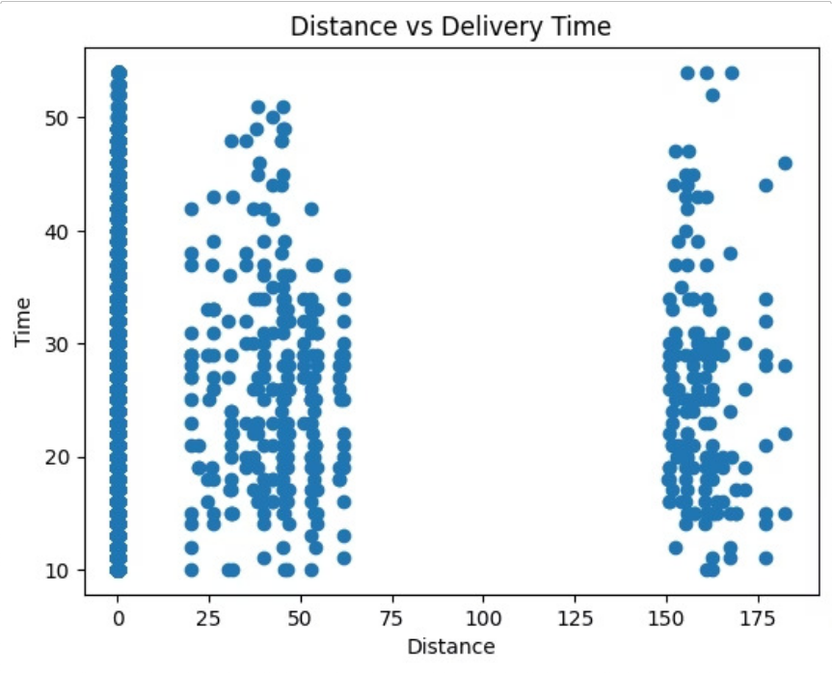
Distance vs. Delivery Time
The relationship between distance and time reveals routing efficiency — deviations from the trend line highlight optimization opportunities.

Slide 10
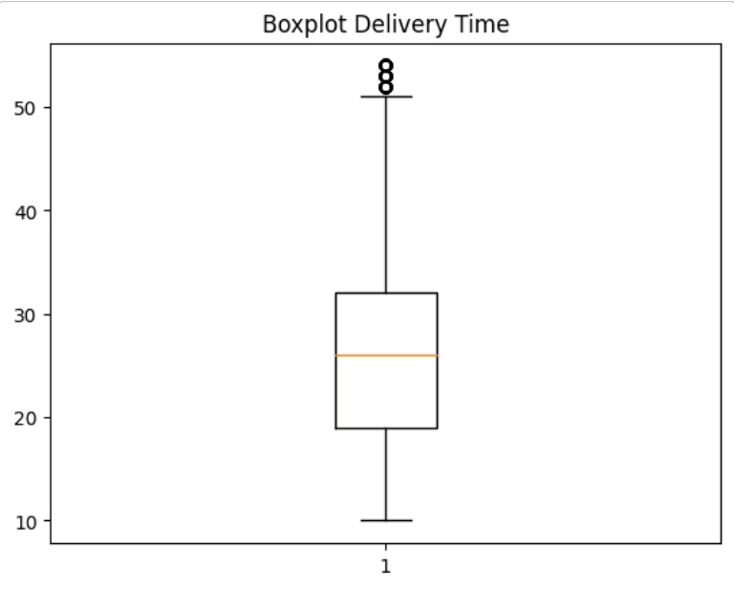
Delivery Time Variability — Boxplot
Consistency is the real metric
Outliers and spread reveal which segments have the most unpredictable delivery times — the true driver of customer frustration.
Median
Typical delivery experience
IQR Spread
Consistency across deliveries
Outliers
Extreme delays to investigate

